Slide 1
Brainstorming

Slide 2
Brainstorming?
People often ask me “What is the number one thing that makes you successful at your job?”
My answer is “I can conduct really good brainstorming sessions” – they usually kick off the start of a great set of client projects
One of your responsibilities as a Business Analyst is to gather and document requirements from the stakeholders. A brainstorming session is a really good place to start.

Slide 3
Why?
A Brainstorm Session is a really good way to get new ideas flowing
I like to conduct it in the first days of conceiving a new project – aka “Ideation”
It is said that companies must re-invent themselves every 5 years or they will fall behind and soon be obsolete
Staying current with technology and usefulness is what keeps a company’s cash flowing
Fall behind and your customers will soon move to your competition
A brainstorming session each year will help keep the ship moving in the right direction

Slide 4
Synergism?
In the context of organizational behavior, we follow the view that a cohesive group is more than the sum of its parts
Synergy is the ability of a group to outperform even its best individual member
Brainstorming exploits this principle
If you ever want to see a principle proven, a brainstorming session will almost always exhibit synergism

Slide 5
Rules of Brainstorming
A brainstorming session follows a small set of very simple but very important rules:
Team should be given the subject and goal a few days in advance
Everyone gets a chance to suggest ideas
No suggestion gets criticized - ever
Timeboxing should be employed for making the suggestions and the overall time to collect them
Final list should be prioritized and assigned a feasibility by the brainstorming team

Slide 6
Preparing in Advance
Giving out the subject and goal for the brainstorming session in advance allows people to do some deep thinking – maybe sleep on the subject and keep a note pad by the nightstand
They should jot down ideas as they come – even the wildest of ideas
Sometimes these are actually the best, or at the least become a catalyst for other great ideas
People should be encouraged to hold their thoughts to themselves – duplication of ideas is not a problem, intimidating others to feel they can’t out do others can be a problem

Slide 7
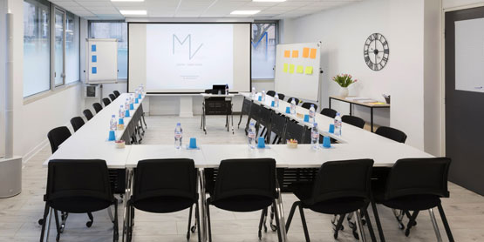
Everyone should participate
When it comes time for the brainstorming session, an orderly process is needed to collect everyone's ideas
A common method is to go around the room with each person submitting one idea on each round – write it down quickly for everyone to see
Quantity of ideas is important too – collecting more will widen the opportunities and can spur other ideas
The facilitator might need to draw out ideas from the shy people. Let them take a pass and come back to them last if needed – everyone should be submitting at least one idea
I like to record the ideas in a spreadsheet so that sorting can be done quickly

Slide 8
No criticism of Ideas
No matter what the idea is, it should not be criticized
What might seem silly at first, could be a the start of the greatest idea ever
By not criticizing you also eliminate the temptation to test an idea for feasibility or tie up time discussing how it might be designed and implemented

Slide 9
Time boxing
Give only a few seconds for the idea to be suggested and write it down quickly for everyone to see – keep the flow moving
A brainstorming session should not take hours to conduct – set an overall time expectation for collection of ideas
Continue around the room until all ideas are exhausted – consider cutting off the flow if time gets constrained – but avoid this if good ideas are still flowing
Do try to collect as many ideas as possible

Slide 10
Feasibility
Feasibility is important – sometimes an idea is just not feasibly
Most often, ideas will be feasible but some might be more difficult to implement
I like to rate each idea as:
Easy = minutes or days work effort
Moderately Difficult = weeks of work effort
More Difficult = months of work effort
Very Difficult = years of work effort
Not feasible at this time
Remember that level of implementation difficulty is not the same as value added and return on investment (ROI)

Slide 11
Priority
Prioritization is very important – it helps build the road map for the future
I like to rate each idea as:
High = must have
Medium = should have
Low = nice to have
Shelf = don’t need at this time
All ideas a good – but some just won’t be needed at the time – store these for next time around

Slide 12
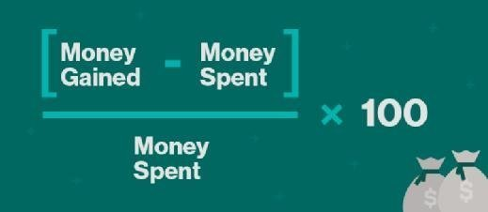
Are we done?
For the brainstorming session – yes, we are done
But, now there are some executive decisions to be made:
What will each idea cost to implement?
What is the expected payback for each idea?
Which ideas do we want to implement and when?

Slide 13
Uses for Brainstorming
Product Roadmap – my most common
Office Productivity Improvement – good for when making a transition to lean/agile
Company Event Planning
Root Cause Analysis – can get fast results
FMECA Analysis – to quickly draw an Ishikawa diagram
More?

Slide 14
Experience Notes
I find that Brainstorming goes better if you have the right people invited - those who care about the outcome
Going offsite seems to help – gets people away from day-to-day distraction
Mornings seem to work better – no burdens of the day on people’s minds yet
I give a 24 hour grace period for late submittal of ideas – never panned out but leaves the door open just in case

Slide 15
Questions?

Slide 16
Exercise
Let’s brainstorm a list of subjects we want to learn more about over the next 12 months
This will help with planning out the chapter calendar
Estimated time will be 30 minutes

