Slide 1
Change Management Offerings
2017
Presented by Scott Mackay

Slide 2
Common pain points that signal a need for change
Need to cut operating costs
Need increased decision speed
Upcoming merger or divesture
Need to control changes for products/services

Slide 3
Activities that determine the magnitude of change needed
Organization Lean Processes Culture Assessment
Organization Agile Change Culture Assessment
Organization/Systems Architecture Assessment
Product/Process Change Governance Process Assessment

Slide 4
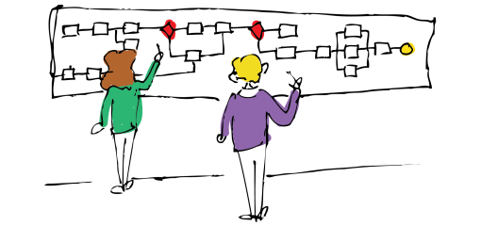
Typical actions that are needed for an assessment
Business Data Mapping
Business Intelligence Mapping
Customer Journey Mapping
Value Stream Mapping
Business Process Capacity & Bottleneck Mapping
Business Process Capabilities Mapping
Skills Assessment
Business Process Change Control Mapping

Slide 5
Typical Assessment Results
Recommendations to move up on a Capability Maturity Model (CMM)
Recommendations to implement best practices
Recommendations to fill process gaps
Recommendations to improve a product or service

Slide 6
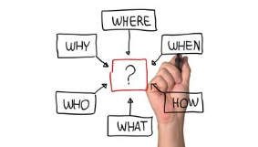
Typical Change Process Activities
Define the change strategy
Develop the change plan
Craft the change communication
Manage the change implementation
Monitor and implement corrections
Assess results and implement corrections

Slide 7
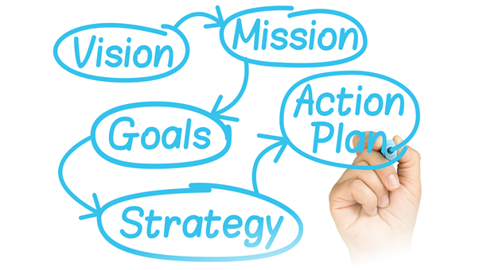
What an Organizational Change Manager does
Define Change Strategy
Develop a Change Plan
Identify Stakeholders & Sponsors
Define the Change Benefits
Mentor Stakeholders & Sponsors
Communicate the Change
Develop Training Materials
Train the Trainer
Measure the Progress of Change Implementation

Slide 8
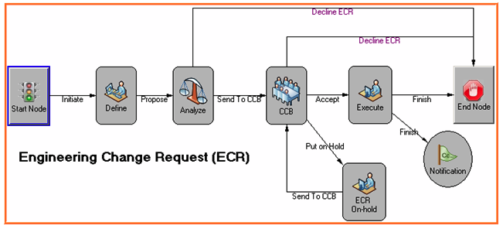
What an Product/Process Change Manager does
Recommend Change Control Strategy
Recommend Change Control Points
Assess Impact of Changes
Assess Benefits of Changes
Recommend Change Implementation Point
Prioritize Changes

Slide 9
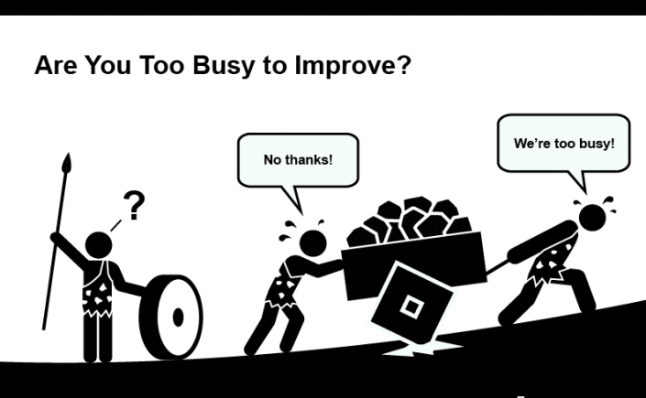
But we don’t have any Change Managers
Like many other roles in smaller companies, the role of change manager often falls on one or more people in the existing organization:
Managers/Supervisors
Project Managers
Business Analyst
Trainers
Internationally, as companies grow in size, the trend is to hire professional change managers who have the specialized training need to manage change effectively
However, in the USA many companies have resisted the change to using professional change managers

Slide 10
The Professional Change Manager
Change Managers exist as a distinct professional group primarily because they have a thorough knowledge of change management principles and how to apply them
Change Managers connect intentionally and systematically with other professionals in a wide range of disciplines to enable effective change to take place

Slide 11
Exploring the CMBOK
Like many other professional disciplines, Change Managers have created a professional organization and collected a Body of Knowledge
The CMBOK covers the principles that CM professionals should know and understand as they perform their day-to-day work

Slide 12
Why be A Change Manager?
Also:
You care about doing change right
You like interacting with people
You have a knack and a passion for managing change
You find it fun and rewarding work

Slide 13
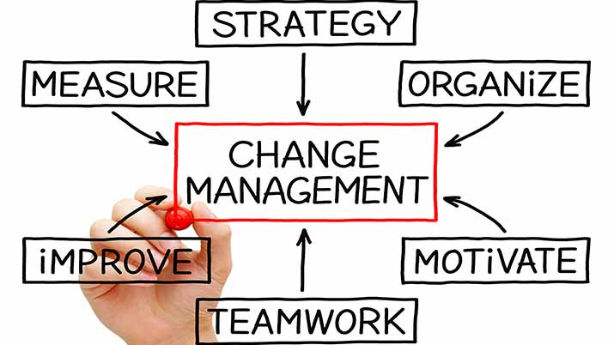
What a Change Manager does
Advocates appropriate and effective change management practices
Defines change, placing it in context
Engages people to the extent necessary for the change initiative to succeed
Helps manage the benefits of change to both the <affected> unit and the wider organization
Supports development and execution of comprehensive plans for change initiatives
Facilitates the change process for individuals, teams, and the wider organization
Ensures that change becomes embedded in the organization – the new “business as usual”
Advises and coaches senior colleagues who are sponsoring or leading change initiatives

Slide 14
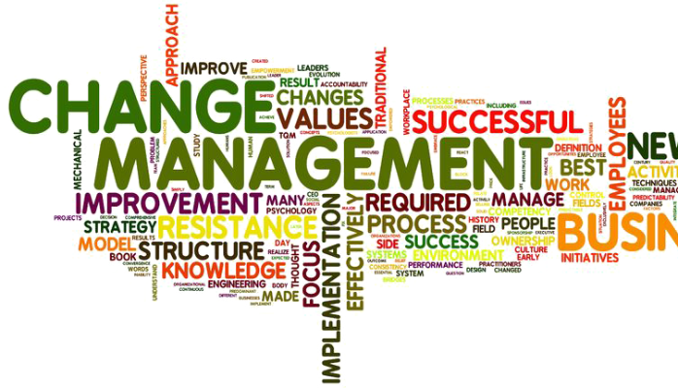
What a Change Manager Knows
Historically, most change initiatives fail to deliver the promised benefits
This fact highlights the importance of a relentless focus on good change management practices
Following good practices greatly increases the probability of successful change
Structuring the change initiative and working with operational managers will ensure the best possible chance of delivering the expected benefits
Not having a plan for change is a de facto plan to fail

Slide 15
Knowledge Components of the Change Management Prospective
CM Core Competency | Why change matters | Change and the individual | Change and the organization | Key roles in organizational change | Organizational culture and change | Emergent change
Facilitating Change | O | O | O |  | O | O
Strategic Thinker | O |  | O |  | O | O
Thinking & Judgement |  | O | O
Influencing Others | O | O | O | O | O
Coaching for Change | O | O | O | O | O | O
Project Management | O |  |  |  | O
Communication Skills | O | O | O
Self-Management |  | O

Slide 16
Why Change Management Matters
Effective change managers must advocate the importance of good practice.
They also need to clearly articulate the high-level factors that lead to effective change implementation.
Organization leaders are often overly optimistic about a change. They see clearly how beneficial a proposed change will be and assume that others will also.
They have confidence that existing situations will easily transfer to the changed situation
They often define too narrowly the range of people who are affected
The change manager’s ability to offer caution, based on good research, can help define the change more realistically
They must also be able to explain the best practices for change in a short “elevator speech”.
It is not the strongest of the species that survives, nor the most intelligent that survives. It is the one that is most adaptable to change. - Charles Darwin

Slide 17
Why Change Management Matters
Change Managers should know:
Current research over the past two decades shows ~30% of all changes are mostly or wholly successful (Hughes 2011).
Applying change management best practices will increase the probability of successfully implementing a change (Prosci 2012).
It is important to prepare the organization and its people for the change.
There are key considerations when designing a change process (Hailey 2008).
Clarity of Roles
Clarity of Vision
Strong Champions
Sufficient Resources
Engagement
Communication

Slide 18
Change and the Individual
Insights from the fields of psychology and sociology about how individuals or groups experience change can be used to support people through the change process.
Change managers understand the human side of change and assure best practices from psychology and sociology are applied effectively to an organizations change initiative.
Process models of individual or group change show change as a function of time.
Each individual will experience change in their own unique way.
The change manager has an education role to help people face change.
Emotional Response Model (Kublar-Ross 1969)
Shock
Denial
Anger
Bargaining
Depression
Acceptance

Slide 19
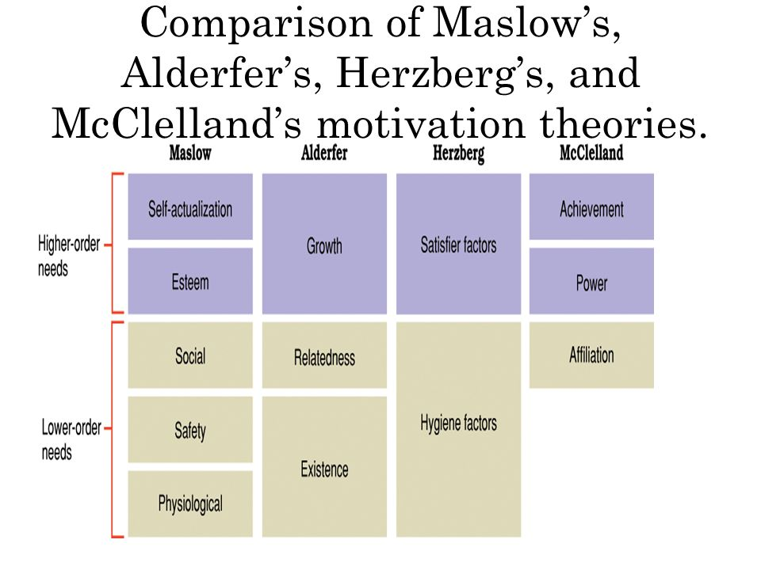
Change and the Individual
The change manager needs a wide range of prospectives on human motivation.
The use and limitations of rewards and sanctions as sources of motivation to change.
The individual drives that shape behavior and their role in helping or hindering change.
Expectancy theories on motivation.

Slide 20
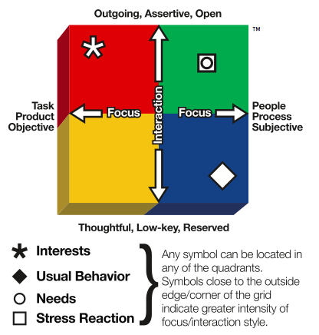
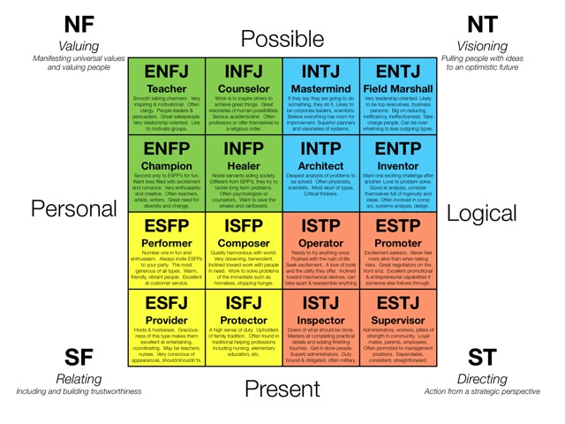
Change and the Individual
The change manager needs to understand individuals are not all the same:
They should understand the many models of individual differences
The should use this knowledge to tailor messages to meet needs of different people with different personal styles
Birkman Method
Myers-Briggs
Personality Assessment

Slide 21
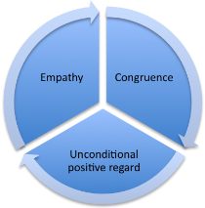
Change and the Individual
In the 1960s, Carl Rogers defined three core conditions that must exist to enable change:
Empathy – understanding how the individual feels about the change (as if standing in their shoes).
Congruence - the individual must consider the change manager and the change advice as genuine and real.
Unconditional Positive Regard – the individual must feel able to discuss the change without fear of persecution or repercussions.
The change manager understands these core conditions must exist to enable change.

Slide 22
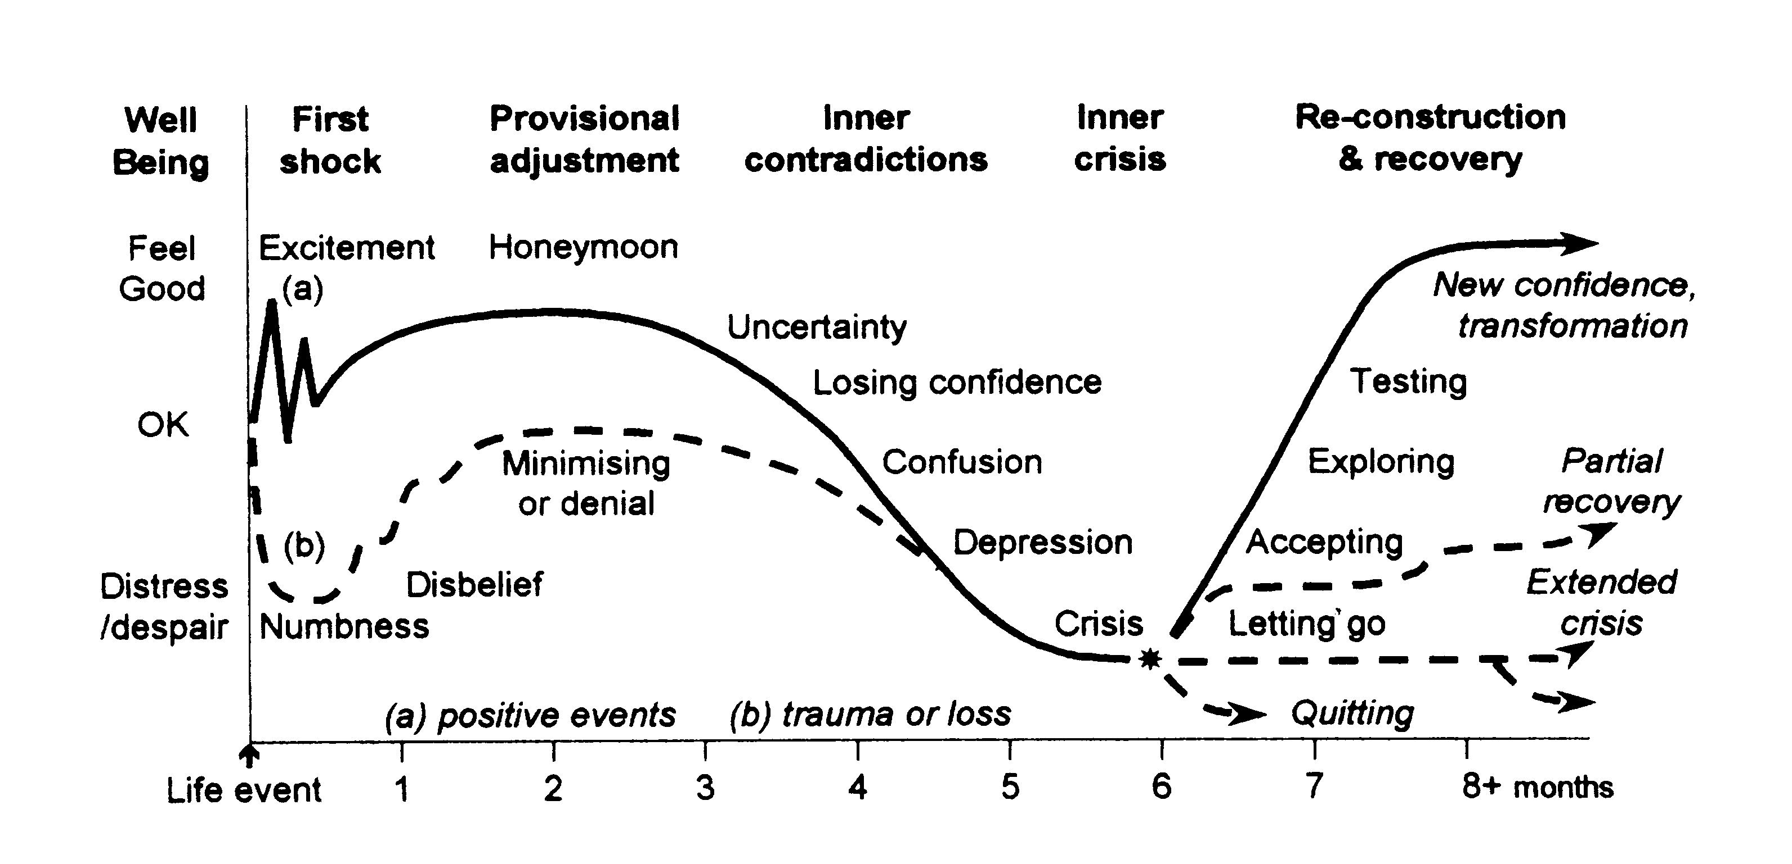
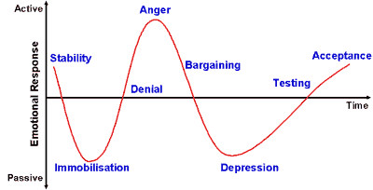
Change and the Individual
Phases and features of the Transition Cycle (Hopson)
The change manager understands:
The “transition curve” change curve, coping cycle.
Behavior patterns for stages.
Appropriate and inappropriate responses from managers.
Kubler-Ross Grief Cycle

Slide 23
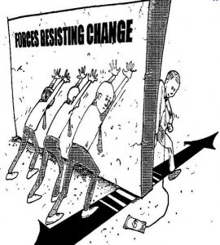
Change and the Individual
Typical ways individuals express resistance:
Ignoring
Acknowledge but not take action
Acknowledge only when being watched, otherwise revert to old ways
Vocally dissent
Defending the old way
Become stressed and hide
Organize a rebellion – passive or aggressive
The change manager needs to know how to:
Mitigate risk of resistance through planning
Quell resistance if it occurs

Slide 24
Change and the Organization
The change manager should know:
Change initiatives vary and require different approaches
Local and narrowly-defined changes need change management as do corporate transformations
The strategy for a change and effort applied must be tailored to the circumstances
Bigger changes often need bigger efforts

Slide 25
Change and the Organization
Change manager must know how to write prescriptions for organizational change (i.e. “n-step” models) that include key people and roles, and the business to be concluded at each stage of the change process.

Slide 26
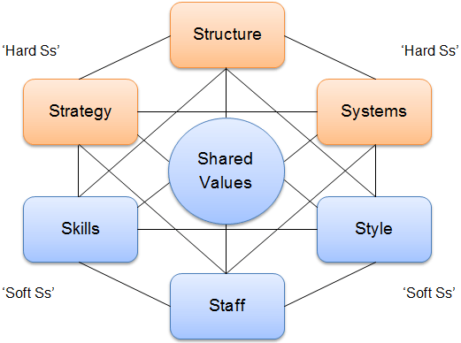
Change and the Organization
The change manager should know how the boundaries inherent in traditional hierarchical organization structures can inhibit change.
And how alternative and parallel structures can be used to enable change to happen more freely.
McKinsey 7s Model

Slide 27
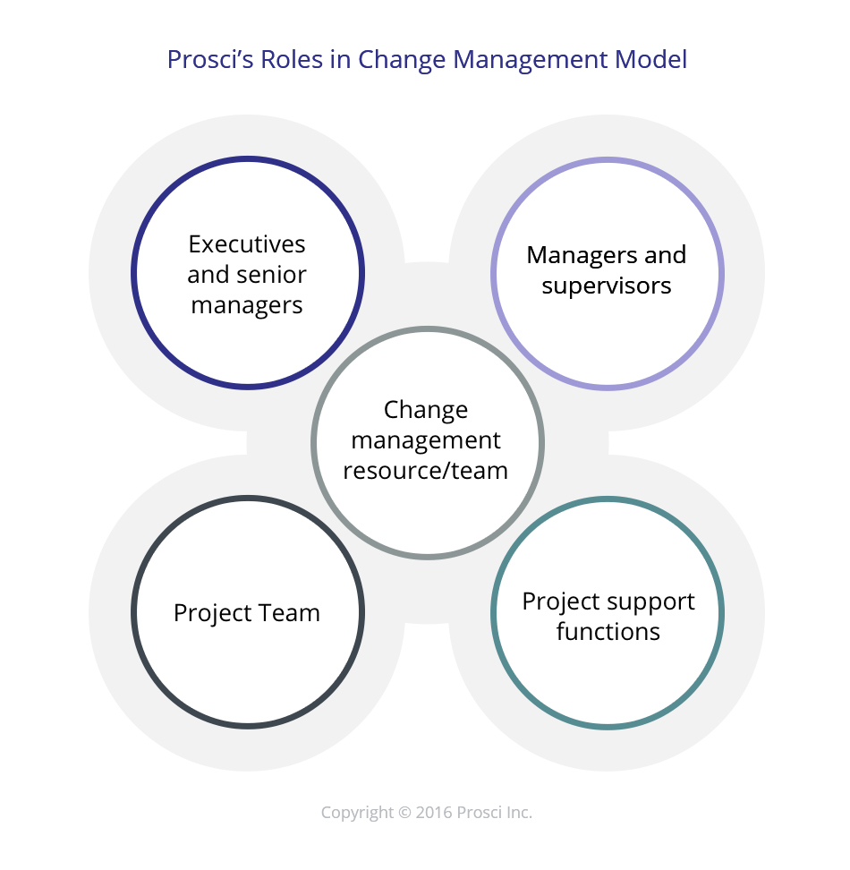
Key Roles in Organizational Change
Change Managers know the key activities of leaders and contributors to change:
Originators of proposals for change
Senior sponsors of change
Line managers and leaders at various levels
People impacted by change
Others who support the change process – change agents

Slide 28
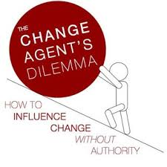
Key Roles in Organizational Change
Change Managers know the role of the change agent. This includes the role of the change manager as well as the roles of those who may act as change agents. Change Managers need:
A well-developed concept of what the role of a change agent is – and what it is not
A clear model of the process associated with change agency or consulting, especially of contracting with those in formal leadership positions.
A practical understanding of organizational culture and how it is maintained.
Insights into sources of power in organizations, and how to achieve influence without authority.
An applied understanding of how to coach colleagues.

Slide 29
Organizational Culture and Change
Organizational culture does not arise by accident – It is the accumulation of organizational experience and belief about “what works”.
This creates a value system that can be strong
However, a deeply embedded value system under on set of circumstances will frequently come into conflict with the requirements of the organization to adapt for the future
Organizational agility results from careful attention to helping people to regard change as a positive and valuable thing.
Inattention to developing agility means that even a simple change can meet with resistance that has roots in cultural lack of agility

Slide 30
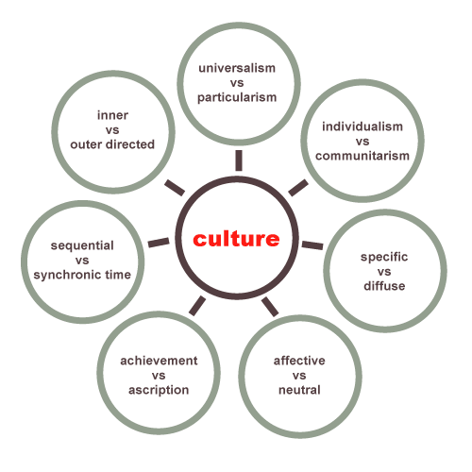
Organizational Culture and Change
The Change Manager should know:
A clear definition of “Culture” in an organizational context
A useful mental model that describes some of the key dimensions of culture
The impact of organizational culture on different types of changes and on the ease with which each can be implemented
The role of organizational leadership in establishing. Maintaining and changing culture, including the cultural “levers” available to senior leaders
Hofstede, Trompenaars, Hamden-Turner

Slide 31
Emergent Change
Emergent change is different:
When the core of the change is to systems, structures, processes and practices, then planning and scheduling is possible
When the core of the change is in the discretionary decisions people make about their patterns of values and behaviors, no dates can be fixed in advance.
People will engage with new patterns of behavior individually and in their own time.
Change Managers must give careful thought to the direction of change that is required and to the indicators which will show progress being made.

Slide 32
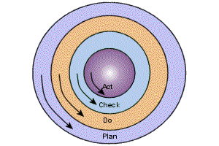
Emergent Change
To help implement emerging change, Leaders can:
Be intentional about their words – challenging existing paradigms and supporting new ones.
Make sure their own actions consistently model the expected behaviors.
Celebrate and mark milestones on the journey
Remain open to new data that might lead to redefinition of the direction – changes in values and behavior are seldom linear or predictable.

Slide 33
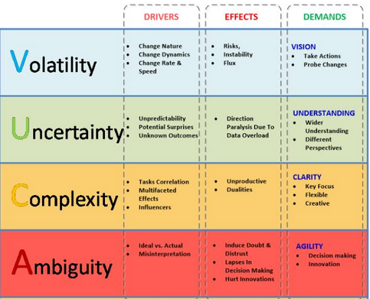
Emergent Change
The effective Change Manager must know:
Categories of change that are likely to contain components of emergent change and how to define those components
Ways to define and describe the patterns of behavior and values that will characterize the organization when the change is successful
Leadership strategies to achieve change in a world that is Volatile, Uncertain, Complex and Ambiguous (VUCA)

Slide 34
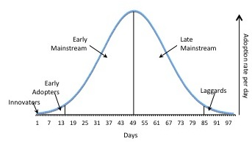
Emergent Change
The effective Change Manager must know how the concepts of critical mass, nudge and tipping point can be used to maintain momentum towards the desired and defined future state.

Slide 35
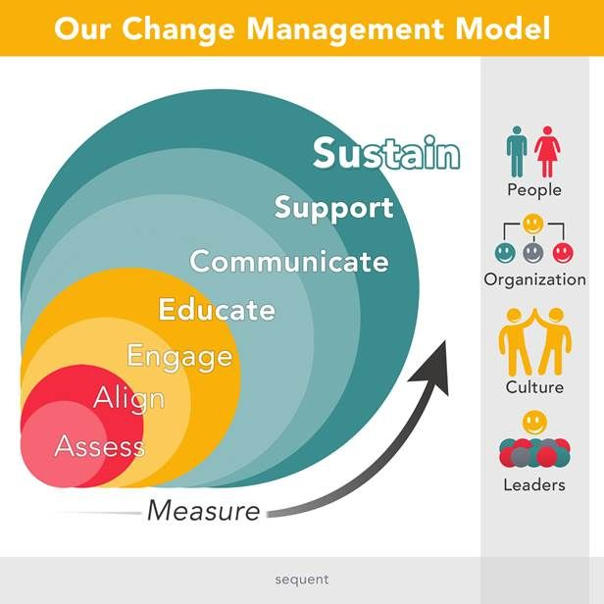
Tips for The Beginner Change Manager
Know the benefits of the change
Show the affected people “what's in it for them”
Keep management involved
Advertise the change, conduct training
Monitor the implementation
Answer people’s questions and assure them that the change is good

Slide 36
Change Management Institute (CMI)
The Change Management Institute (CMI), is an independent not-for-profit organization focused on developing and promoting the practice of change management, internationally
CMI inspires excellence in the management of change by setting standards, educating and supporting change management practitioners and promoting the value of change management
No Chapter in your City - Why not start one?

Slide 37
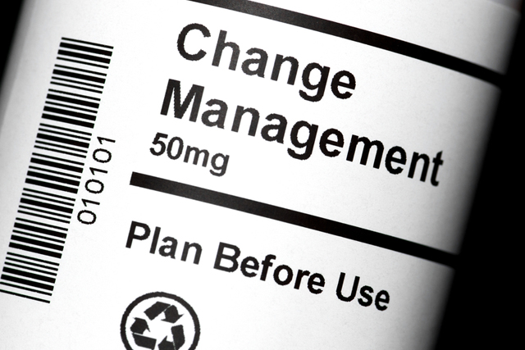
Change Management - Recap
Professional Change Managers are becoming more common
Effective management of changes will reduce churn and turmoil for the organization
Professional Change Managers have the skills and techniques to effectively manage changes
Change Management is a rewarding role for those who have the skills and passion

Slide 38
Questions?
Note: Images used in the presentation are for education purpose only

