Slide 1
Elicitation 101

Slide 2

What is Elicitation?
Elicitation – The activity of gathering <requirements> information
It is the first step in the Requirements Development Process:
  Elicitation (gather information from stakeholders)
  Analysis (extract and classify requirements)
  Specification (write down requirements)
  Validation (review with stakeholders)
One of your responsibilities as a Business Analyst is to gather and document requirements from the stakeholders. This is “Elicitation”.

Slide 3
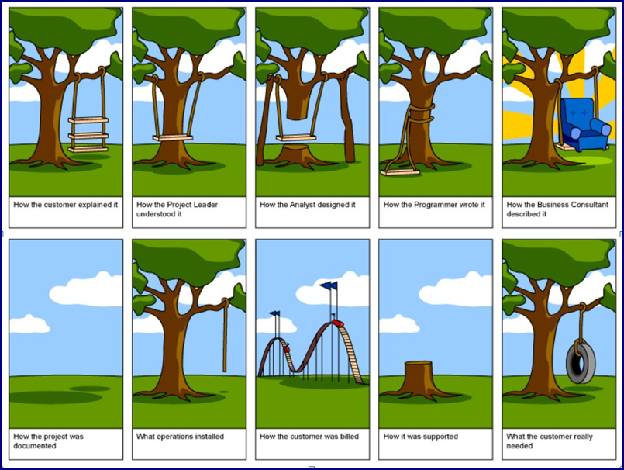
What could go wrong?

Slide 4
How do we get from here to there?
- it starts with good elicitation
A Good Requirement is:
Stakeholders Needs:
Unitary (Cohesive)
Complete
Consistent
Non-Conjugated (Atomic)
Traceable
Current
Feasible
Unambiguous
Specifies Importance
Verifiable

Slide 5
Elicitation – Follow the Process
Prepare Well
Interview Precisely
Document Your Work

Slide 6
Prepare First
- Elicitation Occurs Over & Over
Know what you are eliciting for:
Business Case
Defining the Business Problem to be solved
Defining the Scope (aka The Project Frame)
Defining the Future State & Expected Gains
Business Requirements
Defining the Business Functional Needs
Defining the Business Non-Functional Needs
Defining the Assumptions & Constraints
Business Models
Defining the Workflows
Defining the Business Object Models
Defining the Use Case Models
Use Case Requirements
Defining the User Stories or Use Cases
Defining the Business Rules
It is rare to do these all at once

Slide 7

Prepare First
- Know your audience
Know who the Stakeholders are:
  Who has the most say?
  Who has the closest knowledge?
  Who is affected by the change?
  What is their Role?
  What is their Responsibility?
  Which are needed for the task?
  How can you communicate with them?
  What technique will be best?
Also, let your Stakeholders know how much time you need from them in advance!

Slide 8
Prepare First
- Know your problem space
Do your homework:
  Get the background info
  See the business problem
  Plan which documents you will be creating
  Plan the right venue for your elicitation encounter
You don’t need to be the SME for understanding or solving the problem, but you do need to be the SME for how to facilitate, document and communicate.

Slide 9

Prepare First
- Know your Tools
Master the Tools first
Use MS Word for:
  Glossary
  Problem Statement
  Business Case
  Business Requirements Document
  Use Cases
Use MS Visio Professional for:
  Workflows
  Use Case Model
  Business Object Model
  Storyboards
  Project Frame
  Future Shaping Plan
Use MS PowerPoint for:
  Presentations

Slide 10

Prepare First
- Set your Goals
Plan out your schedule
Plan individual goals
Example:
  Define the Business Problem
  Identify the Best Solutions
  Write the Business Case
  Define the Project Scope & Future Shaping Plan
  Model the Future State
  Define the Business Requirements
  Define the Solution Requirements
  Define the User Stories/Use Cases
Bite off pieces that build on the next step

Slide 11

Interview Precisely
- Choose a Process and Tools
Best Practices for Elicitation
  Choose a Process
    Focus Group/RPM Workshop – fast, gets everyone at once
    Interviews/Delphi – slow and disjointed, usually requires follow-ups
    Observation/Interface Analysis – good for getting started, too siloed
  Choose a Tool
    Brainstorming – good for defining solutions
    Process Modeling/Prototyping – visual and fast, validates at same time
      Storyboarding
      Process Mapping
      Use Case Modeling
      Object Modeling
    Decision Analysis – good for choosing between alternatives
    Questionnaire – hard to ask the right questions and interpret answers

Slide 12
Interview Precisely
- Choose an Interface and Venue
Best Practices for Elicitation - continued
  Choose an Interface
    Face-to-Face (best for RPM)
    Video Conference
    Shared Screen Conference
    Voice Conference
    Emails
  Choose a Venue
    Off-site – good for keeping focus
    Conference room - close to others
Choose the best process, tool, interface and venue to reach the desired goal.

Slide 13
Interview Precisely
- Perform the Elicitation
Your job is to get the right information from the stakeholders and document it such that all stakeholders see the same solution vision!
Be clear on what you want to accomplish
Facilitate toward your goal at all times
  Don’t let your meeting get side tracked on other topics
  Don’t let dominant personalities rule
  Draw out comments from passive participants
Document your work – share it live if possible
Think about what makes a good requirement

Slide 14
Interview Precisely
- How do you know when your are done?
Have you captured all of the requirements?
  Did any obvious requirements get missed?
  Did you list Assumptions & Constraints?
  How many unknown unknowns exist?
  How long will it take to discover everything?
  What if the Stakeholder thinks of more later?
Get what you can! It will never all be there on the first round.

Slide 15
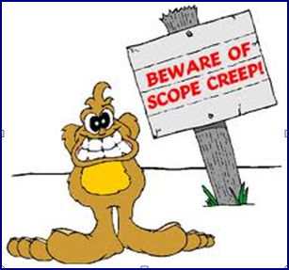
Interview Precisely
- Stay within the Project Frame
Constantly check to be sure requirements all trace back to the project goal:
  Are the requirements you’re collecting in the project frame (in scope)?
  Is your meeting busy discussing something other than the project requirements?
Don’t be part of scope creep!

Slide 16

Interview Precisely
- Be the Business Analyst
Stay in your role!
  You are the Business Analyst
  Your expertise is Requirements
  You need to Stay Focused on Requirements Elicitation
Don’t get outside your role!

Slide 17
Document Your Work
You might need Interview Notes or Meeting Minutes
  Especially if you are working with other BAs
Best practice is to put information directly into the Requirements Artifact Drafts
  Do this live in the elicitation meeting if possible
  If you have multiple BAs in the meeting, give each a different artifact to build and let them share the projector periodically to validate their work
This is where our RPM Methodology shines!

Slide 18
Requirements Artifacts
- the ultimate results from your elicitations
Problem Statement
Business Case
Project Frame (what’s in/out)
Future Shaping Plan (road map)
Glossary
Business Requirements Document (BRD)
System Requirements Specification (SRS)
Future State Workflows
Storyboards
Use Case Models
Business Object Models
Use Cases/User Stories
Project Requirements
One document for a small project
Multiple documents are more typical

Slide 19

Validate Your Work
Publish your work and ask Stakeholders to review
Give the opportunity to correct and change the information
If you were sharing during your elicitation, still do this
This is the “2” part of our RPM 4-4-2

Slide 20

Experience Notes
The BA must also remember who said what such that later edits don’t change a Stakeholder’s expectations
There will always be later changes as more of the future vision becomes clear to the Stakeholders
Give priority to the Stakeholders closest to the problem
Think about Risk Mitigation and Requirements Tracibility early and often
  Mitigate biggest Risks early as the project progresses
  Trace Requirements to Implemented Features to assure Stakeholders expectations are met

Slide 21

Questions?

