Slide 1
“The Change Request (CR)” A Lunch & Learn Event
2018
Presented by Scott Mackay

Slide 2
Who am I?
Scott Mackay – Business Analyst in the Atlanta Business Alignment (BA) LOS
30+ years' experience in software & hardware
Lost track of how any change requests processed
Sat on several Change Control Boards with Rockwell International & Boeing Defense Systems
Lean process practitioner
Industrial Engineer

Slide 3
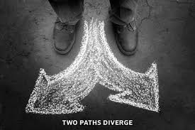
Change Management?
Change Management has two broad and very different areas of application:
Managing changes to products or services
Managing changes to people and organizations
Change management professionals will generally chose one or the other area to specialize in
Both are quite important
This presentation will focus on managing changes to products and services aka “Change Control”

Slide 4
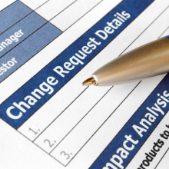
Change Requests have many names
Change Request (CR)
Request for Change (RFC)
Engineering Change Request (ECR)
Engineering Change Proposal (ECP)
Request for Design Change (RDC)

Slide 5
Change Decisions have many names
Change Notification (CN)
Engineering Change Notice (ECN)
Design Change Notice (DCN)
Product Change Notice (PCN)
Waiver
Deviation

Slide 6
What is a Change Request?
A suggested change to a product or service
Typically suggested with intent of making improvement
Reducing operations cost
Increasing market share
Most often anyone can request a change
Some companies will solicit change suggestions
From employees
From product users
Maybe even build a suggestion box into their product
Some companies will conduct periodic brainstorming sessions to discover change suggestions

Slide 7
What is a Change Request?
Any change made to the product requirements should be presented initially through a change request
The change request should describe the proposed change and why it is needed
It can be formal – fill in a form and track progress
Or informal – suggest it and brainstorm its potential value
Ultimately, a change that might go forward should get properly assessed for impact to cost, schedule and quality, and then documented in a product backlog

Slide 8
Waterfall Change Requests
In a Waterfall Methodology, changes are typically presented to a Change Control Board (CCB) at key decision points in the change process life cycle
The CCB will review change proposals and approve them to go forward
In more complex situations, a Configuration Management Board (CMB) might also be involved
Configuration Management (CM) assures that changes will be compatible with other in-flight changes such as operating system upgrades, hardware upgrades, new feature sets, etc.
Waterfall typically loses points for making the change process too difficult
Good changes get missed
The quest for excellence gets squelched

Slide 9
Configuration Management?
Configuration Management assures that changes will be compatible with other in-flight changes such as operating system upgrades, hardware upgrades, new feature sets, etc.
More importantly, the release point must get defined
When is the best point to add this new feature?
Will it work with older operation systems and hardware?
Must we wait for a new operation systems or hardware version?
Is it a major version change (ex: 8.0 becomes 10.0)?
Is it a minor version change (ex: 8.0.0 becomes 8.0.1)?
You might also have Configuration ‘As Built” records that document which products included which changes

Slide 10
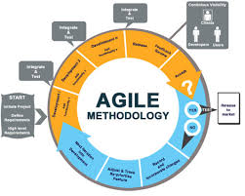
Agile Change Requests
In Agile, they profess that they simply put the change into the backlog for a future sprint
Reality is that the Product Owner must still perform some level of assessment to assure the change will provide a benefit to the customer without breaking the bank for the company
Agile gets extra points for “embracing change”
Changes are considered a normal part of building a product

Slide 11
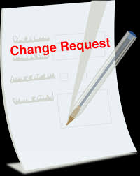
All Change Requests
Regardless of Methodology, the level of formality for processing a change should be proportional to the risk for the change – higher risks need more stringent scrutiny before proceeding
All changes will cost money before they start to make money
Most changes will improve the quality or utility of the product or service
Many changes will reduce the recurring cost of the product or service
Some changes will extend the life of the product or service
Ex: Redesigns for newer platforms
Some changes should never go forward
Studies show that as much as 20% of a products features are rarely or never used
Do the cost trade studies and say no if needed

Slide 12
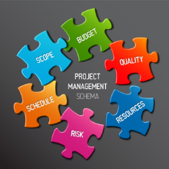
Change vs. Project?
A change is a de facto project
It might become a small project within a larger project
It might grow to become a project of its own
It might be so small that its hardly noticed– and can get missed
It might have its own cost & schedule tracking
It might have its own traceability

Slide 13
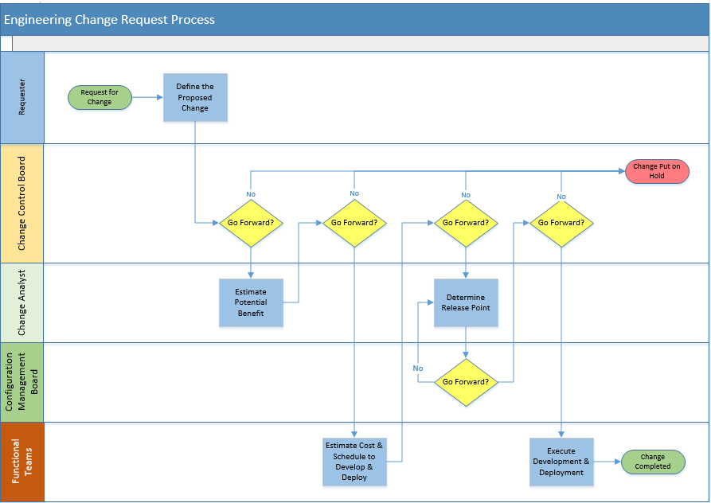
Sample Life Cycle of an Change Request

Slide 14
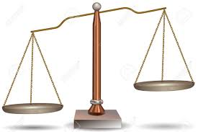
Change Process - Generic
Most company's design their own change control processes
Focus on balance of good control and lean process
Leanest approach is to let the Product Owner have total control of changes – and total responsibility for profit and loss
Don’t be afraid to design your own process – just include the right controls

Slide 15
Why have a Change Control Process?
It reduces the possibility that unnecessary changes will be introduced to a system without forethought
Run-away changes will contribute directly to cost over-runs
The goals of a change control process usually include:
Minimal disruption to services
Reduction in back-out activities
Cost-effective utilization of resources
Change Control Police?

Slide 16
Change Control Process
The typical change control process can be described as a set of six steps:
Record / Classify the change
Assess the impact and benefit
Plan the development
Build / Test
Implement
Close / Gain Acceptance

Slide 17
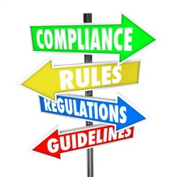
Change Process – Government Contracts
There are some strict rules that typically get imposed on government contracts:
Approved Change Management Plan
Standard classifications (Major, Minor, Class I, Class II)
Defined Change Control Board Members
Defined Configuration Management Board Members
Mandatory disclosure of impact to Customer
Right of Customer to approve/disapprove a change
Product payments might change based on contract type (Share in the profit or loss)
The government tries hard to minimize and reduce costs – the only rules that stay are the important ones
Same principles, just enforced

Slide 18
The Important Stuff – Impact to the Business
Is the change going to add value to the product?
How much value?
What is its expected lifeline?
What will it cost to develop and deploy?
Is there an impact to operational costs?
New licensing?
New skills, tools, hardware?
Is there a negative impact to customers?
Harder to use?
Drains battery faster?
Bogs down processor?
Can cause personal harm?
What is the payback point?
My usual checklist to help you be your best

Slide 19
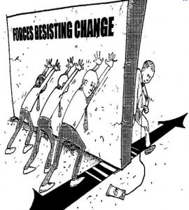
The Important Stuff – Impact to People?
Do we need to do some Organizational Change Management?
Is this change impacting people?
New software data or features?
Methods & procedures change?
Job description change?
Reduction in workforce?
Training needed?
If yes, bring in a profession OCM person early on to develop a change strategy and start the OCM change process
Get the affected people involved with crafting and owning the solution – Make them part of the team and a contributor to the success of the business
Failure to plan is a plan to fail – An OCM person involved in the change request process can make a difference!

Slide 20
Change Control and the Organizational Change Manager
Why should an OCM person care about change control?
Bad change control decisions can make the OCM part harder
The OCM person has the best skill set to decide if a potential change might need OCM help and how much of it.
Some companies won’t spend the money to staff a full time OCM professional but will staff a full time change control manager.
Being a “hybrid” increases your chances at getting the dream job you are after.
Change control is not hard if you know the principles of the process.

Slide 21
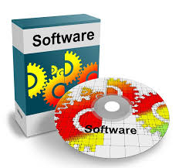
Software Changes
Software changes are typically much easier to deal with than hardware changes
A few things to consider:
Must it deploy with other features to be able to work? Ex:
New OS coming out?
New hardware coming out?
Part of a new feature set?
Does it correct a vulnerability? – put on fast track?
Will some prototyping be needed? – include funding?

Slide 22
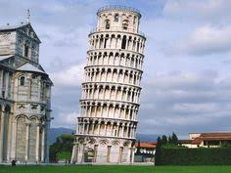
Hardware Changes
Hardware changes can get expensive very fast
There are many cost factors:
Will some prototyping be needed?
Using up current parts inventory?
Effect on spare parts?
Forward & backward interchangeability?
Impact to weight, size, durability, visual?
Reliability testing?
Destructive testing?
Recertification of product?
Affects product warranty?
When the second floor was built in 1178, the tower started to lean. This was because it had a small three-meter foundation in soft soil.

Slide 23
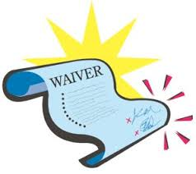
Special Types of Change Requests
Waiver
A request to release contractual obligation for meeting a customer’s requirement
Could also require a discount in price or extension of warranty
Deviation
A request to substitute a part or feature with an almost equivalent
Could also require a discount in price or extension of warranty
In the 1986, the space shuttle Challenger had a waiver to allow launch at a temperature much lower than the operations manual specified.
Waivers & Deviations inherently taint the product’s quality – avoid using them

Slide 24
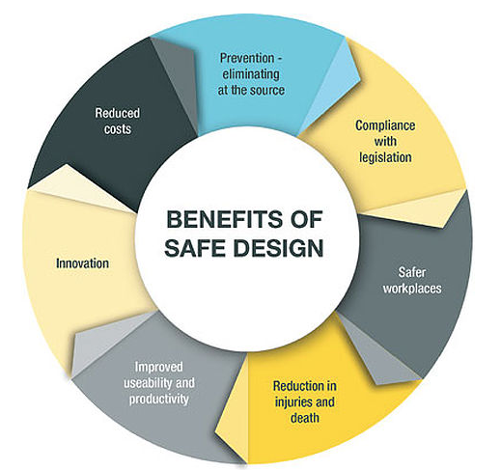
Changes Where Safety is Affected
Safety related changes require more stringent analysis
Can it increase the risk of personal or environmental harm?
Could failure lead to lawsuits?
Examples:
Robots/Drones
Automotive safety & driving devices
Airplane safety & flying devices
Breathing air mixture controls
Radiation emitting devices
Medical devices
Food processing devices
Industrial power controls
Power tools

Slide 25
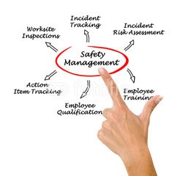
Safety and the Organizational Change Manager
Why should an OCM person care about Safety?
Many employee behavioral problems show their symptoms through workplace accidents.
An OCM person with some safety compliance background is in a good position to be of extra value to a company.
Being an OCM/Safety Compliance Manager “hybrid” increases your chances at getting the dream job you are after.
Safety compliance is really common sense.
Getting employees to think about safety is the harder part and falls directly into what OCM people do best.

Slide 26
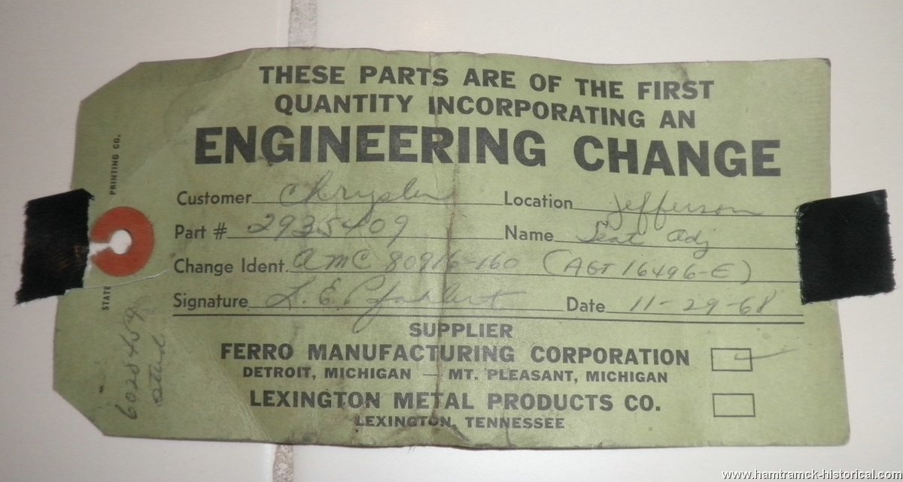
Tracking Changes
User Stories & Use Cases should include notation for version control
Version control should tie tightly to change control & release control
Record the approved change request as part of the reason for changing the version
Changes should be traceable to the product by release number/date, or by serial number
In the 1960s, tags were attached to products to indicate they had a change made that might affect there usability
This data may be needed for product warranty or recall

Slide 27
Typical Change Request Information
Information | Section
Requester Name & Date of Submittal | Request
Enhancement or Defect Fix? | Request
Description of Change | Request
Priority | Request
Reason for Change | Request
Attachments | Request
Cost to Develop & Deploy | Analysis
Potential Benefit | Analysis
Months to Payback | Analysis
CCB Decision, Authorizer’s Name & Date of Disposition | Disposition
Target Cut-in Point | Disposition

Slide 28
Wrap up
Changes are normal and necessary
All changes need some level of cost, schedule, quality analysis
Level of analysis is proportional to product risk
Most changes are for improving or sustaining a product
Companies should have a documented process for enacting changes
Leaner and faster are better
Some changes will require Organization Change Management
Being a Hybrid OCM person will help you
Sometimes the right answer is no
You should track which product included which change
Quoting the immortal words of Alfred E. Newman: Just because everything has changed, does not mean it will be any different

Slide 29
Questions?
Note: Images used in the presentation are for education purpose only

